Slide 1
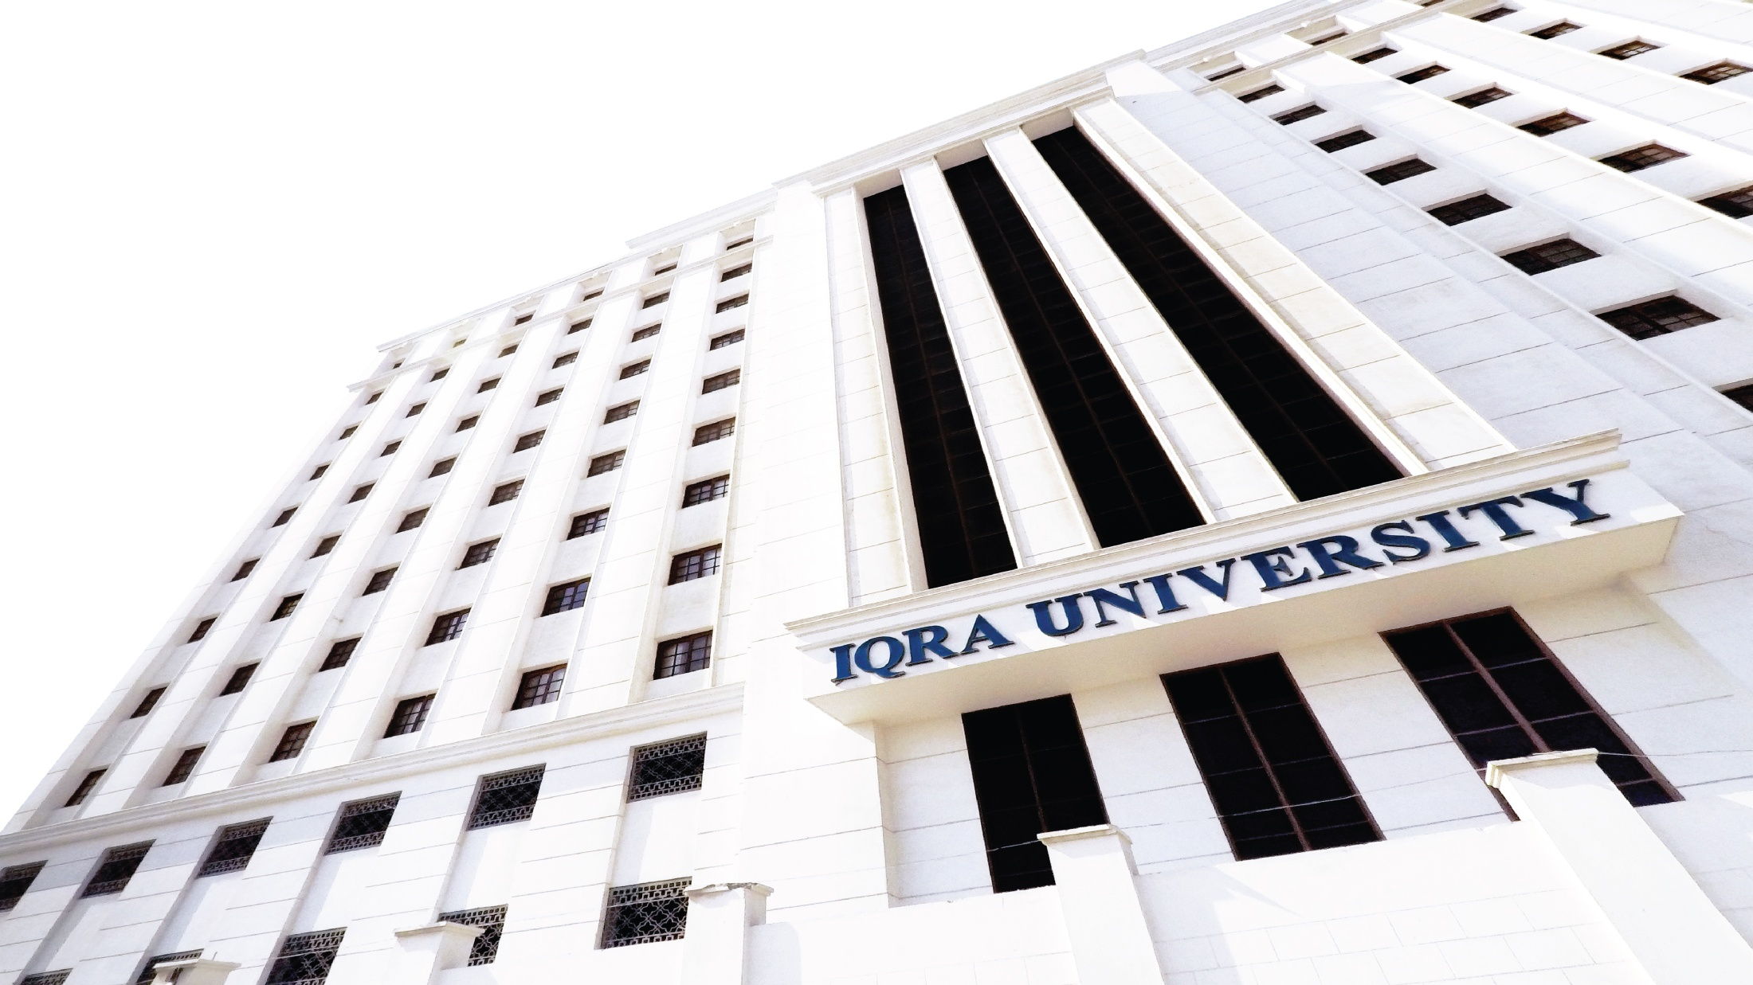

Unit 2.1
Verbal Communication Skills

Slide 2
Verbal Communication
Verbal communication uses words to communicate ideas
across to the audience.
It includes both spoken and written types of communication.
However, generally the term is used to refer to oral
communication.

Slide 3
Elements of Verbal Communication
Words
Sentences
Literal & Figurative Meanings
Denotations, Collocations & Connotations
Formal/Informal/Slang words

Slide 4
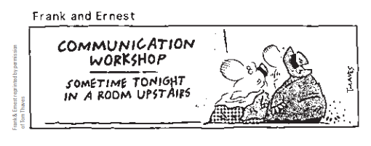

Slide 5
Strategies for Improving Verbal Communication Skills
Use clear and precise language.
Use vocabulary according to the level of your listeners.
Avoid using jargon.
Use inclusive language.
Use non-offensive language.

Slide 6
Remember an Acronym
Honesty: be clear and straight.
Authenticity: be yourself.
Integrity: be as good as your word.
Love: wish your listeners well.

Slide 7
References
Guffey, M. E., & Loewy, D. (2016). Essentials of business
communication (10th ed.). Cengage Learning.
Notes:
There are many rules for following APA format, and the facilitator should stress that it is nearly impossible to memorize them all. Students’ best course of action is to utilize the official APA handbook or the APA section in an updated composition textbook as guides for properly using the documentation format. Since the American Psychological Association, a professional group of behavioral and social science professors and instructors, periodically updates the guide, students should be certain that they are using the most current information possible.
There are other resources for finding current information on APA documentation style. The APA web site offers some limited information about recent format changes, especially regarding the documentation of electronic sources. The Purdue University Writing Lab has a page on APA formatting and documentation style on its website: https://owl.purdue.edu/owl/research_and_citation/apa7_style/apa_formatting_and_style_guide/general_format.html
For quick questions on APA format, students can also call the Writing Lab Grammar Hotline at 494-3723.

